Slide 1
Financial Fraud Detection
with Imbalanced Data

Slide 2

Overview
Challenge
Approach
Goal
Detecting fraud in highly imbalanced datasets where legitimate transactions vastly outnumber fraudulent ones
Compare multiple ML models focusing on recall and AUC metrics rather than simple accuracy
Build robust fraud detection system balancing interpretability with predictive performance

Slide 3
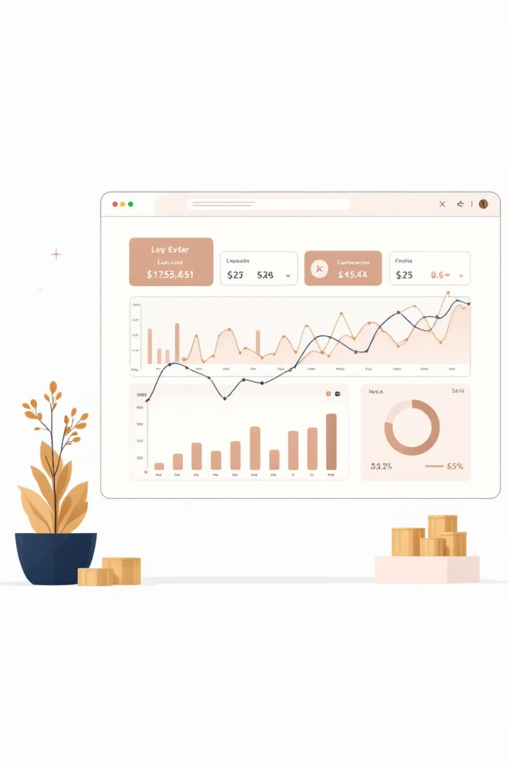
Dataset Characteristics
Scale & Structure
Key Features
50,000 synthetic transaction records
Transaction_Amount, Account_Balance
Binary target: Fraud_Label (1=Fraud, 0=Legitimate)
Transaction_Distance, Device_Type
Multi-level features: transaction, user, and device
Merchant_Category, temporal patterns
Data source: Kaggle synthetic fraud detection dataset designed to mirror real-world transaction patterns

Slide 4
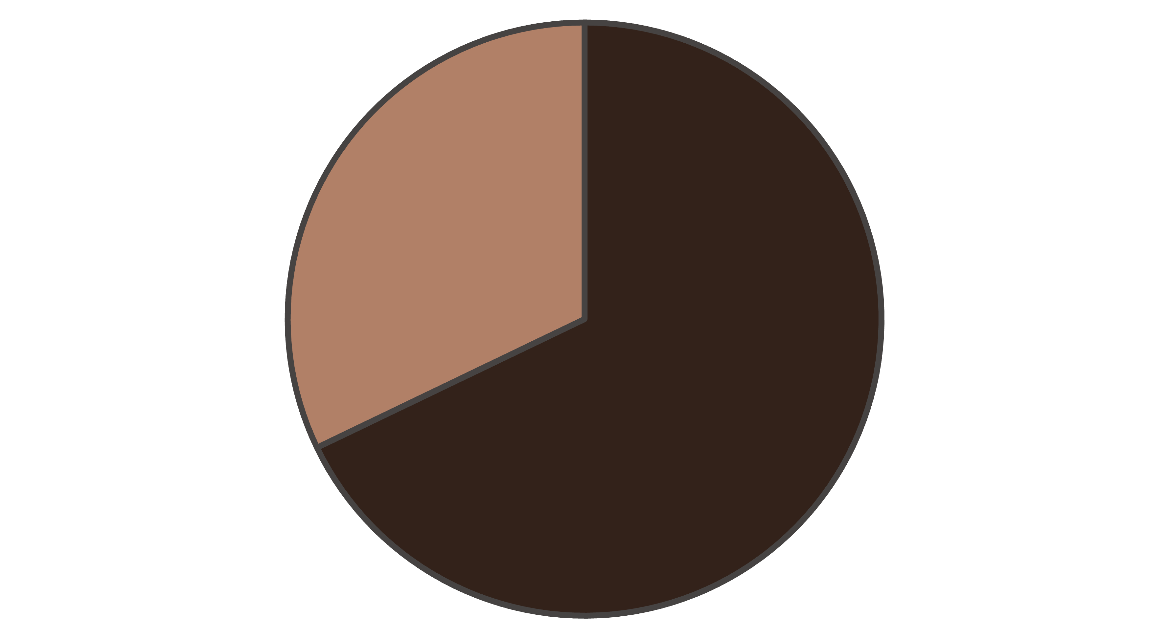
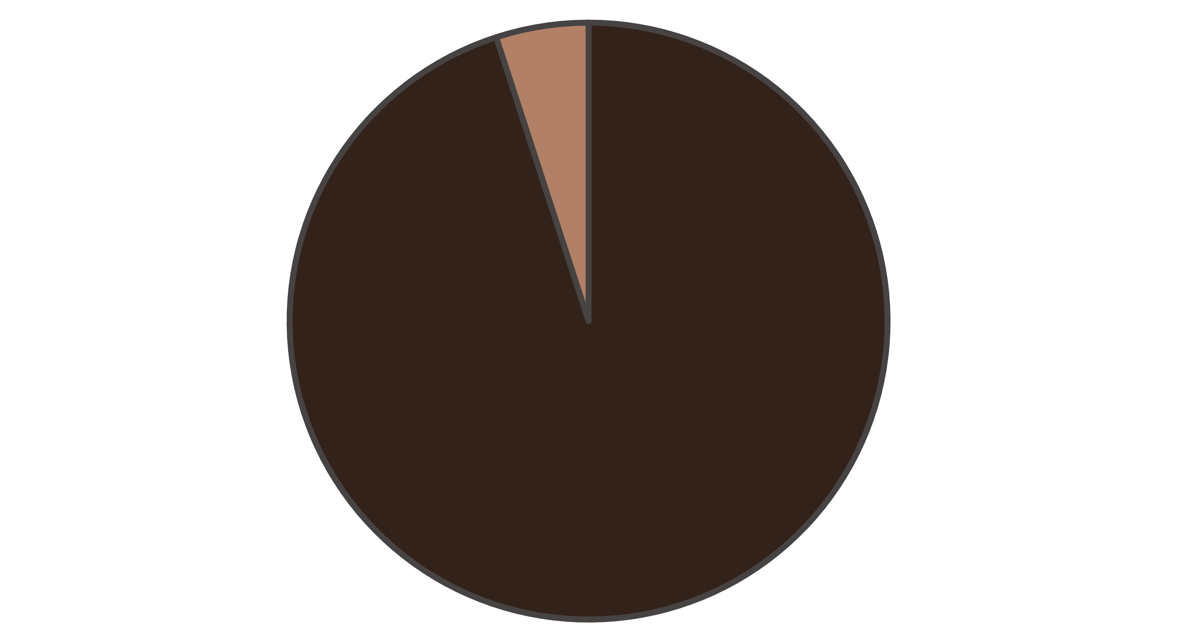
The Imbalance Challenge
Legitimate
Fraudulent
The dataset exhibits class imbalance with 32% fraudulent transactions which mirrors real-world scenarios where traditional accuracy metrics can be misleading.

Slide 5





Data Preprocessing Pipeline
Data Cleaning
Removed transaction IDs, user IDs, and timestamps to focus on predictive features
Feature Encoding
One-hot encoding for categorical variables like Device_Type and Merchant_Category
Feature Scaling
StandardScaler applied to numerical features for optimal model performance
Stratified Split
70-30 train-test split maintaining class distribution in both sets

Slide 6




Model Building
Logistic Regression
Decision Tree
Interpretable baseline model providing clear feature importance and coefficient analysis for understanding fraud indicators
Non-linear decision boundaries with interpretable rules, though prone to overfitting on complex patterns
Random Forest
XGBoost
Ensemble of trees reducing variance and improving generalization while maintaining interpretability
Gradient boosting optimized for imbalanced data with hyperparameter tuning for maximum performance

Slide 7
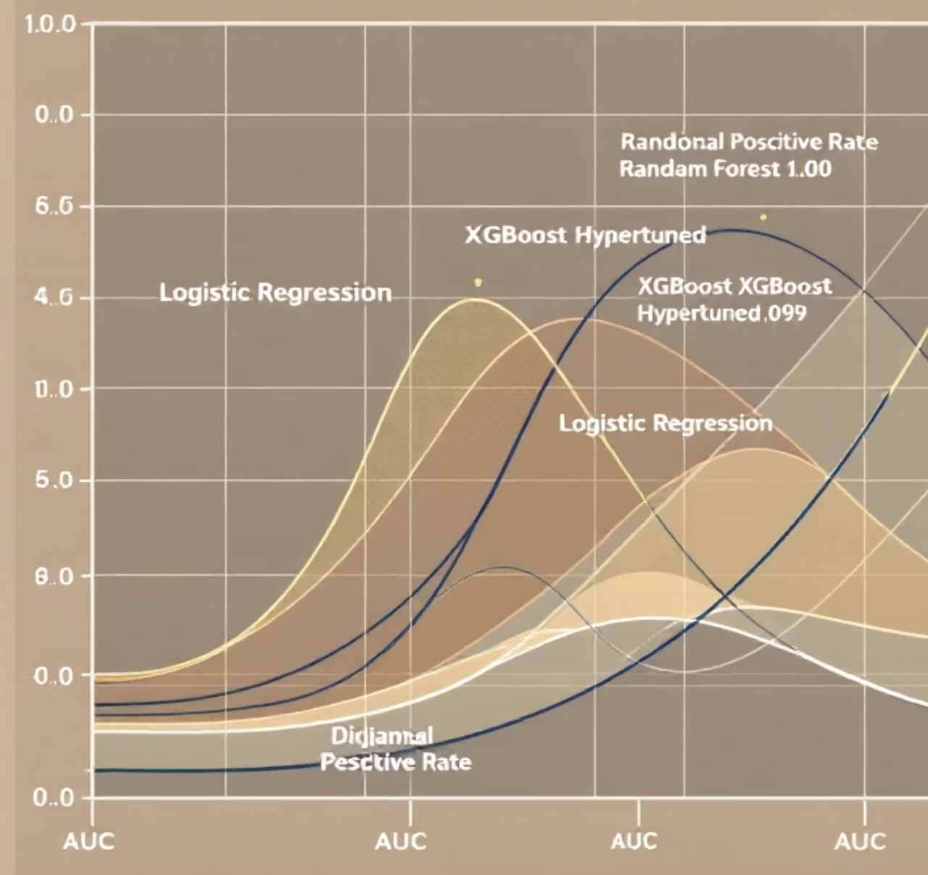
Evaluation Strategy
Key Metrics
Recall: Critical for catching fraud cases
ROC-AUC: Overall discrimination ability
Precision: Minimizing false alarms
F1-Score: Balanced performance measure
Accuracy alone is misleading with imbalanced data - a model predicting all transactions as legitimate achieves 95% accuracy but catches zero fraud.

Slide 8
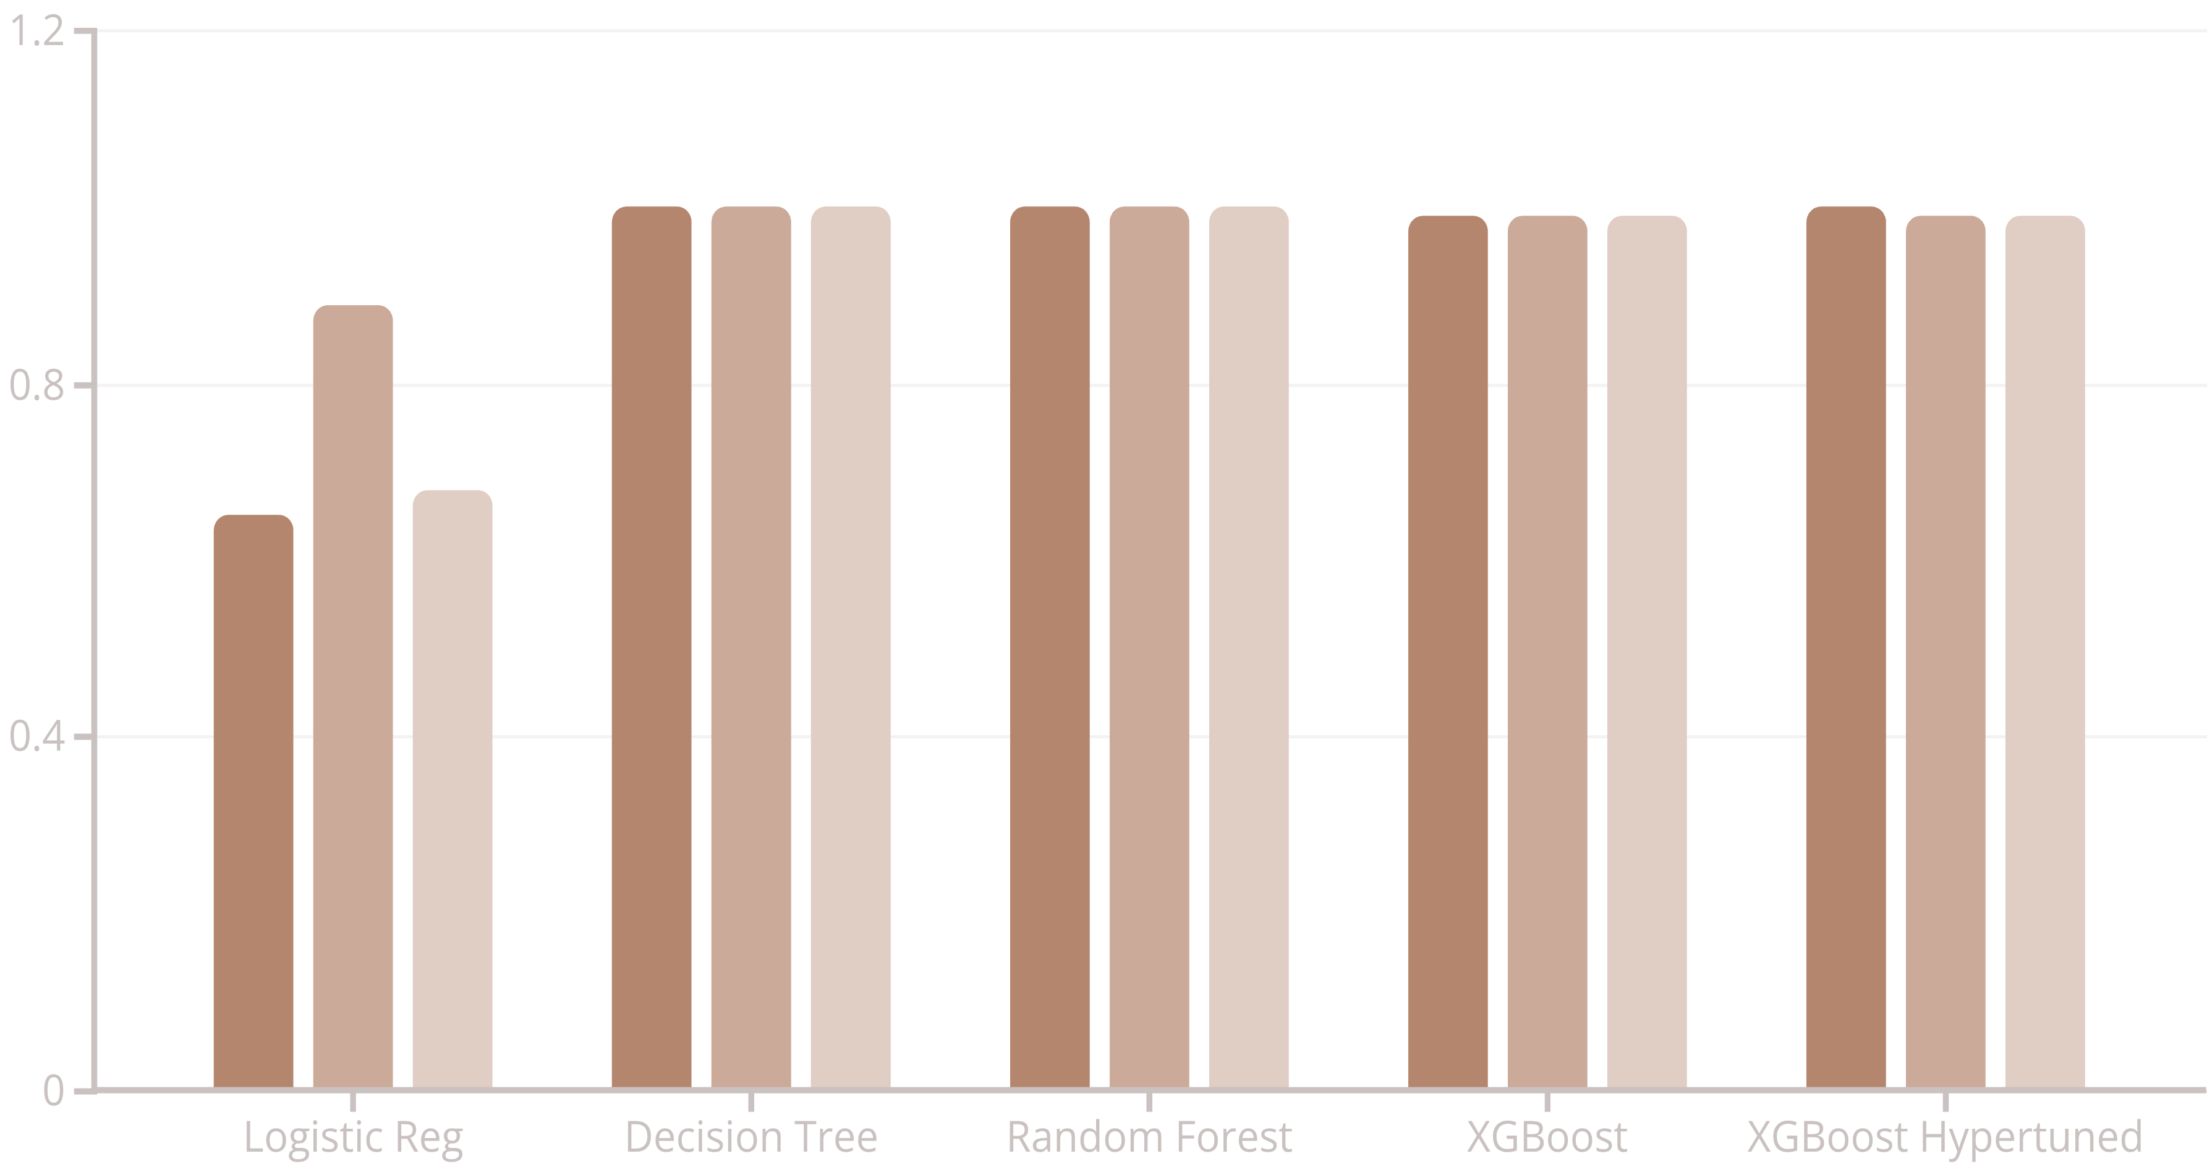
Model Performance Results
Recall
ROC-AUC
F1-Score
The Decision Tree and Random Forest models demonstrated perfect performance, achieving a score of 1.0 across all metrics (Recall, ROC-AUC, and F1-Score). XGBoost Hypertuned also showed strong results with perfect recall (1.0) and near-perfect ROC-AUC (0.99) and F1-Score (0.99). In contrast, Logistic Regression had the lowest performance across all evaluation metrics.

Slide 9




Key Insights & Learnings
Top Model Performance
Metric Selection
Hyperparameter Impact
Decision Tree and Random Forest achieved perfect scores (1.0 across all metrics), while XGBoost and its hypertuned version also demonstrated exceptional performance.
Recall and AUC proved essential for imbalanced fraud detection, while accuracy alone was misleading.
Hyperparameter tuning improved XGBoost's recall from 0.99 to 1.0, demonstrating its value in fine-tuning model performance.

Slide 10

Future Enhancements
Advanced Sampling
Feature Engineering
Implement SMOTE and ADASYN for synthetic minority class generation
Extract temporal patterns and behavioral anomalies for enhanced detection
1
2
3
4
Cost-Sensitive Learning
Real-Time Deployment
Develop asymmetric loss functions reflecting real-world fraud costs
Build scalable pipeline for live transaction monitoring and alerts
This comprehensive fraud detection framework demonstrates how ensemble methods can effectively handle imbalanced data, providing a robust foundation for real-world financial security applications.

Slide 11

Your attention and engagement today are greatly appreciated. I hope this presentation offered valuable insights into my approach to financial fraud detection with imbalanced data.
Contact & Follow-Up
Email: singhanshukumar224@gmail.com
GitHub: https://github.com/anshu5159/Financial-Fraud-Detection-With-Imbalanced-Data
Dataset: https://www.kaggle.com/datasets/samayashar/fraud-detection-transactions-dataset

